Slide 1
Data warehouse
by: Faten El Outa

Slide 2
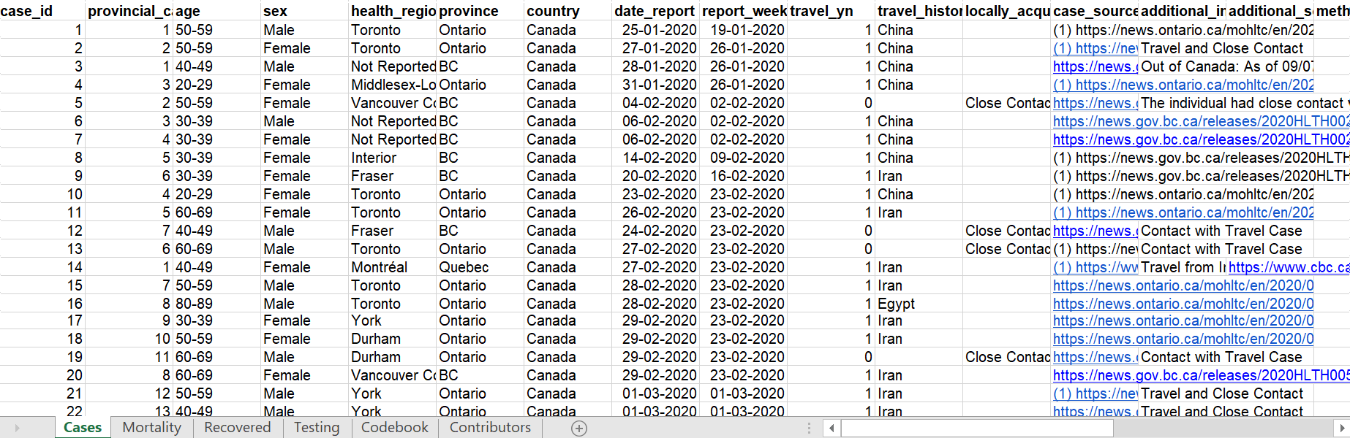
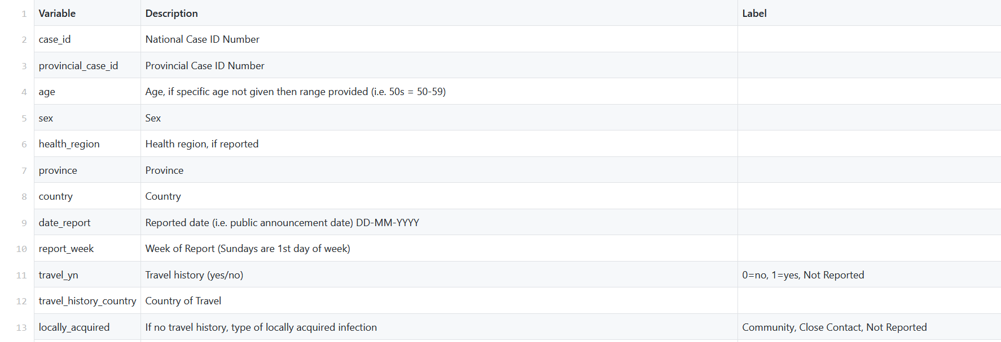
Public_COVID-19_Canada
https://github.com/ishaberry/Covid19Canada/blob/master
https://docs.google.com/spreadsheets/d/1D6okqtBS3S2NRC7GFVHzaZ67DuTw7LX49-fqSLwJyeo/edit#gid=942958991
ToTal row:111016

Slide 3
DF Covid Canada data
Sex
Covid-Canada
nb-cases
nb-death
cumulative-recovered
Cumulative-testing
Age
Age-Range
Health-region
Province
Date
Month
Year
Travel history
Travel country

Slide 4
Data Description
Attribute | Description
sex | String: male, female
Age-range | <20;[20,29] [30,39];[40,49] [50,59];[60,69] [70,79];[80,89] [90,99];[100,109] Not reported
Travel history | Boolean: Yes, no, not reported
Travel country | Country of travel
Health region | Health region if reported
cumulative_recovered | Cumulative number of recoveries

Slide 5
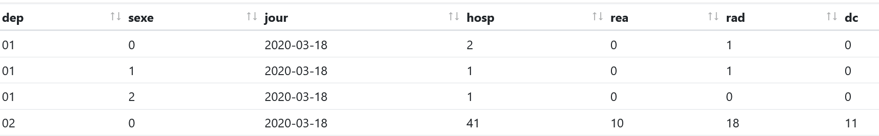
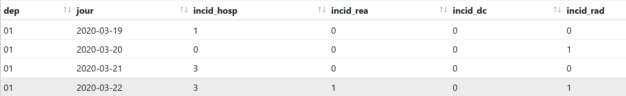
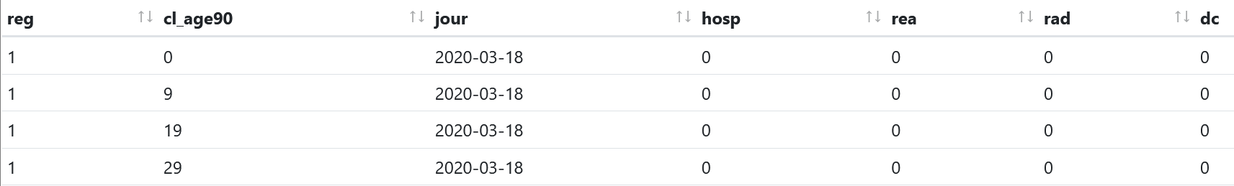
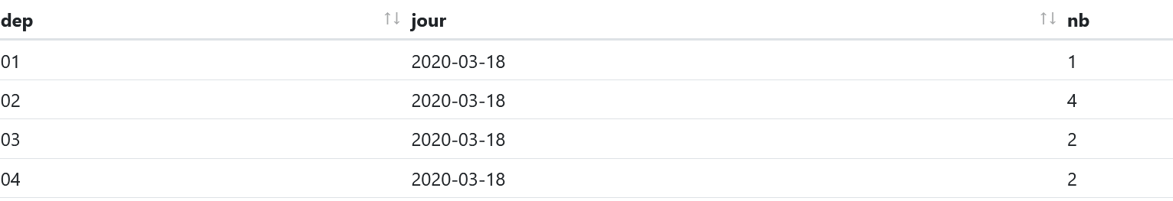
French COVID Data(Data.gouv.fr)
https://www.data.gouv.fr/fr/datasets/donnees-hospitalieres-relatives-a-lepidemie-de-covid-19/#_
ToTal row:36667

Slide 6
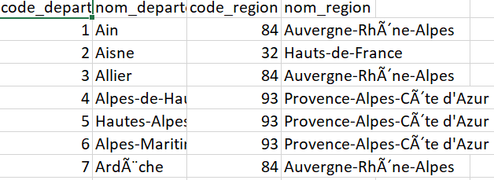
DF Covid French data
Sex
Covid-French
nb-cases
nb-death
cumulative-recovered
Age
Age-Range
Department
Date
Month
Year
Department can be enriched by joining this data: department, region

Slide 7
Data Description
Attribute | Description
department | integer
sex | integer
Age-range | 0 all age; A<15;B 15-44;C 45-64;D 65-74; E>75
hosp | Number of people currently hospitalized
rea | Number of people currently in resuscitation or critical care
rad | Total amount of patient that returned home
Total amout of deaths at the hospital | Total amout of deaths at the hospital

Slide 8
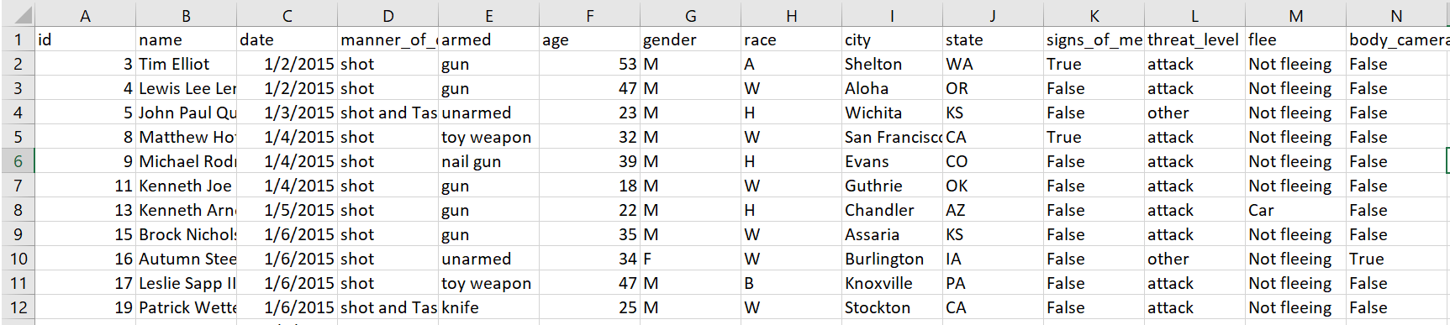
Data-police-shootings
ToTal row:5417
https://www.kaggle.com/mrmorj/data-police-shootings

Slide 9
DF data-police-shootings
Age
race
armed
Police-shooting
mean of shooting
Signs-mental-illness
gender
City
State
Day
Month
Year
Questions that you can analyze, for example:
What about rate of shootings
What is the rate of killings relative to race and age
Which states have the most kills
To enrich data police shooting: add info about policer
-number of policers on the scene
-number of round to hit the target

Slide 10
Data Description
Attribute | Description
Age | integer
armed | String: gun,knife,unarmed…
gender | String: M,F,none
race | W: White, non-Hispanic B: Black, non-Hispanic A: Asian N: Native American H: Hispanic O: Other None: unknown
signs_of_mental_illness | Boolean: True, false

Slide 11
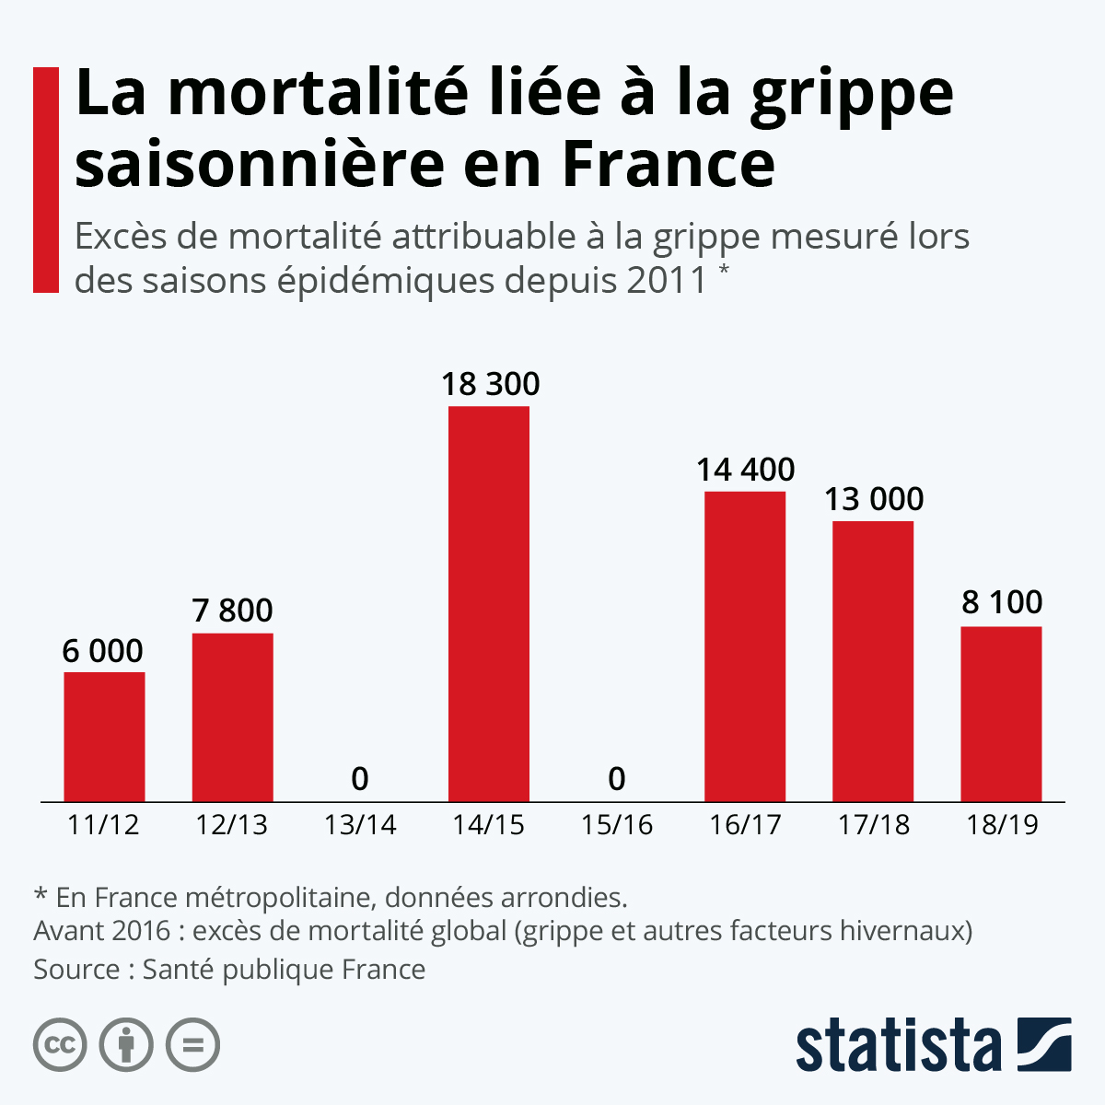
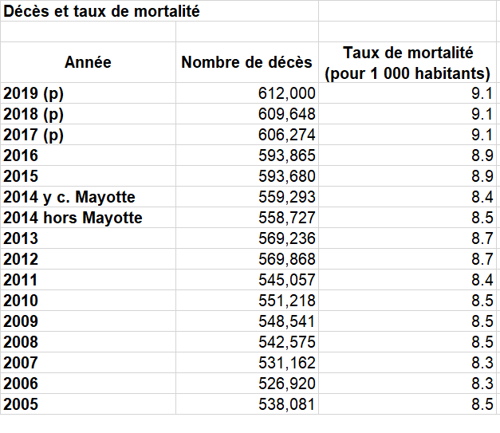
Benchmark
https://www.insee.fr/fr/statistiques/2383440
https://fr.statista.com/infographie/11358/mortalite-de-la-grippe-en-france/

